Slide 1
Introduction to Computer Programming Lecture 11.5:
Review : Object Oriented Programming (OOP)
Hemma Philamore
Department of Engineering Mathematics

Slide 2
Why use classes?
Modularity
Allows you to break down your code into smaller sections.
Identify and fix problems
Reuse in multiple programs
Reusability
More flexible reuse than standalone functions, modification via inheritance.
Polymorphism
Methods/attributes with the same name can have different functionality for different classes
e.g car.drive(), bike.drive()

Slide 3
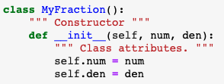
Anatomy of a class
Class name
Convention: begin with capital letter
Keyword ‘class’
parentheses
colon
Indentation
Constructor:
Runs automatically when a class object is created
Notes:
Wrong of what goes in arguments start from this point again

Slide 4
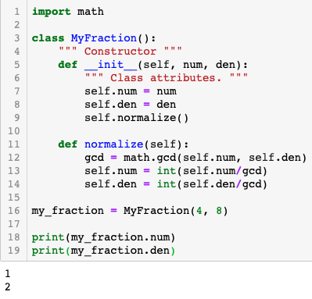

self. behaves like the pronoun 'my’
Inside the class, we are talking about my num , my den → self.num, , self.den
Outside of the class → my_fraction.num
('my', means someone totally different when said by someone else.)
Class object created

Slide 5
Q.11.5.A
Write a Python class which has two methods:
get_String : request string from user and assign value to class attribute
print_String : print the string in upper case
Q.11.5.B
Write a Python class, Square_analyser which:
is constructed using a single input argument, h (length of one side).
has two methods:
area : prints the area of the square
perimeter : print the perimeter of the square

Slide 6
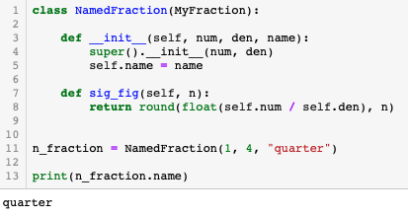
Inheritance
Name of parent class
super()
Allows you to call the parent's version of the method and add to it.
Initialise super class (i.e. the parent class that the child class is derived from).
New methods can be added to the child class
Notes:
Messed up. Retake

Slide 7
Q.11.5.C
Write a child class, Rectangle_analyser, inherited from Square_analyser (Q.11.5.B), that:
is constructed using two input variables:
h - height
w - width
has two methods:
area : prints the area of the rectangle
perimeter : prints the perimeter of the rectangle

